Slide 1

Leveraging Existing Assets for New Markets – First Street
Stephen Stesney – Product Manager
TOC 2012 - NYC
February 15, 2012

Slide 2
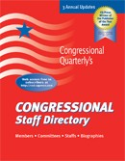

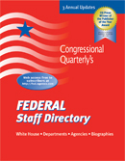
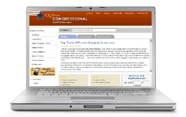
CQ Press Directories
Leveraging Existing Assets for New Markets - TOC 2012

Slide 3
Market for Directories
Core Market
  Almost entirely print-based subscriptions
    Government
    Professional
Secondary Market
  Leading electronic subscriptions
    Associations
    Media
Stable, mature market

Slide 4


Slide 5

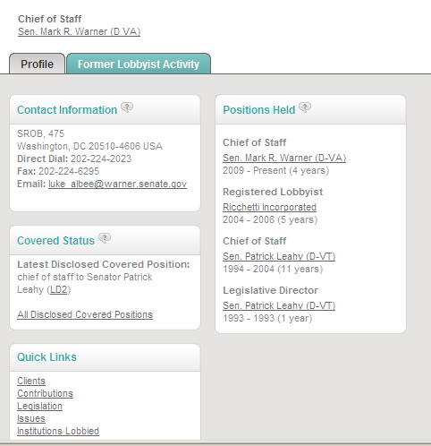
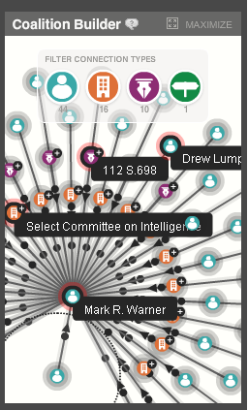

Slide 6
How did we do it?
Digitized 20 years of Congressional and federal staff directories
Painstakingly disambiguated the data to create complete work histories
Added government data to enhance the directory data
Created a dynamic interface and cool visualization

Slide 7
What is it?
“politically-minded LinkedIn” - Mashable
“a sort of LinkedIn for Washington insiders making it perhaps the most powerful social network you've never heard of” – Fast Company
“a bit like a Facebook for lobbyists, allowing someone to peer into people’s histories and professional connections” - The New York Times

Slide 8
Creating a New Market
First Street enables CQ Press and Sage to move beyond the directory market
Political Intelligence market
  Data driven solution providing key intelligence about people and legislation
    Who are the players in policy debates?
    How are they related?
    Why are they involved in the issue?
    What legislation are they lobbying?

Slide 9
Market for First Street
Professional
  Law/Lobbying Firms
  Corporations
  Political organizations
  Recruiting firms
Associations
Media
Government
Academic

Slide 10

Check it out for yourself
Sign up for a free 14 day trial:
  http://firststreet.cqpress.com
  Promo Code: TOC
First Street Research Group
  Exclusive reports and analysis of First Street data
  http://firststreetresearch.cqpress.com/

